Slide 1


Bus Booking and Management
Maryam Diallo

Slide 2
Agenda
Vision
SQL | Tables | Joins | Query
Live demo
Q &A

Slide 3
Objectives
Manage users, buses, routes, ticketing, payment, and feedback
1
Passengers can register as Non-Amin User s
2
Admin can manage bus agencies, schedules, and bus information
3
Non-Admin Users can book tickets and access trip details
4
Enhance the bus reservation process by making it organized, transparent, and accessible for all.
5

Slide 4

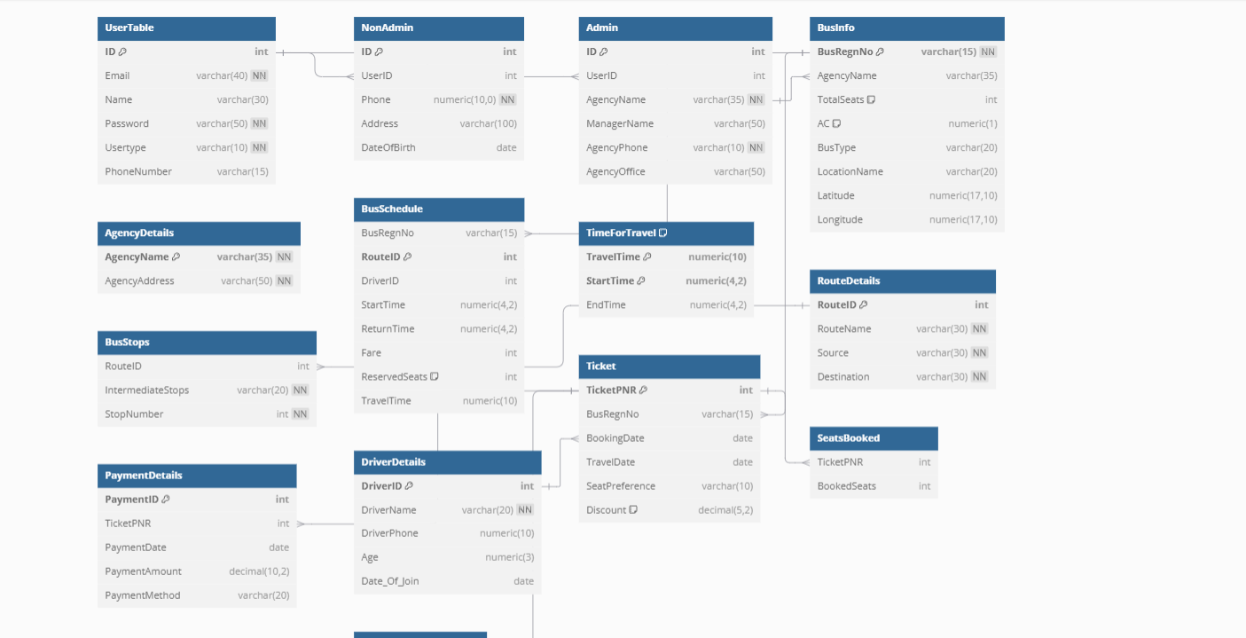




Slide 5
Business Rule
User Registration: A user must provide a unique Email and PhoneNumber during registration.
Each bus is tied to a unique agency and follows a specific route with defined stops and schedules.
Payments and feedback are tied to valis tickets, and feedback ratings range from 1 to 5

Slide 6
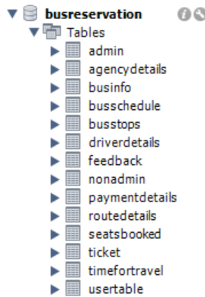
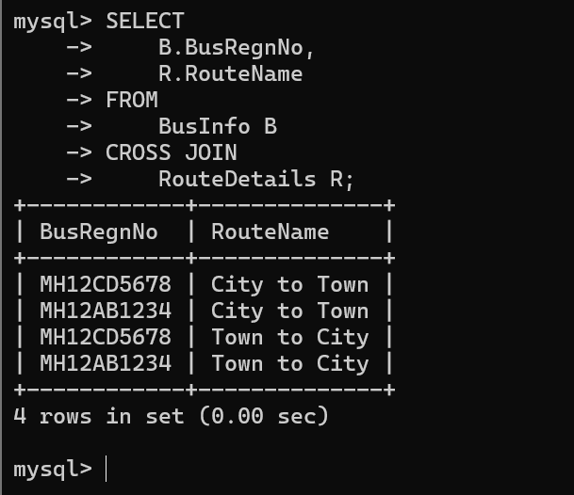
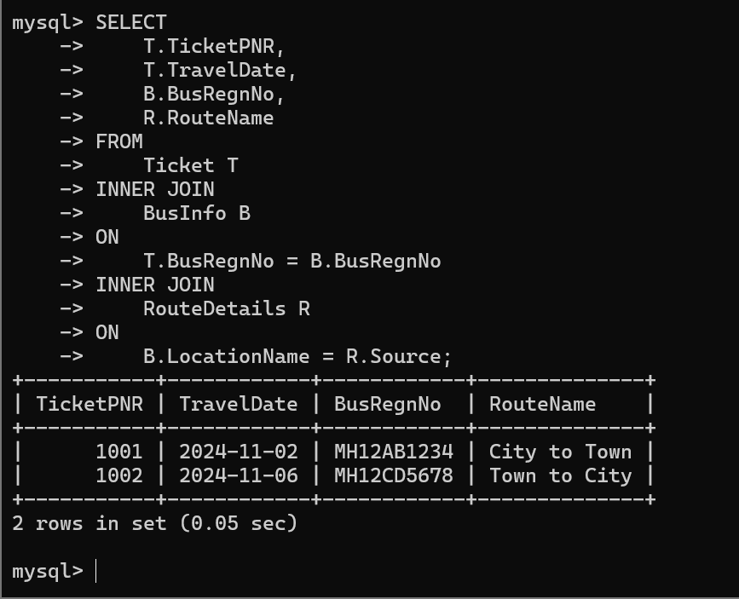
Table | Query | Join

Slide 7

Q & A

